Slide 1
CSE 3210 Computer Organization and Programming
Chapter 1 Basic Concepts
Dr. Zulkar Nine
mnine@gsu.edu
Georgia State University
Spring 2021

Slide 2
Outline
Welcome to Assembly Language
Some concerns
Applications
Virtual Machine Concepts
Virtual Machines
Machine Levels
Translating Language
Data Representation
Boolean Operations

Slide 3
Welcome to Assembly language!
Programming is fun!

Slide 4
What is an assembler, a linker, a debugger?
Intel Assembly code
Source
File
Assembler
Object
File
Intel Machine Language:
A1 00000000
F7 25 00000004
03 05 00000008
E8 00500000
mov eax,A
mul B
add eax,C
call WriteInt
Source
File
Assembler
Object
File
Linker
Executable
File
Source
File
Assembler
Object
File
Link
Libraries
debugger

Slide 5
Some issues
What hardware/software do I need?
Computer 32/64 bit
Windows + Microsoft Visual Studio
Mac + Virtualization software (Virtualbox) + Windows + Microsoft Visual Studio
What types of programs will I create?
Mainly 32-Bit, Some 64 bit
What do I get with this book?
http://www.asmirvine.com/

Slide 6
More issues
How does assembly language (AL) relate to machine language?
One-to-one relationship
How do C/C++ relates to AL?
C/C++
Is AL portable? No. Why?
Assembly
int Y;
int X = (Y + 4) * 3;
mov eax,Y ; - move Y to the EAX register
add eax,4 ; - add 4 to the EAX register
mov ebx,3 ; - move 3 to the EBX register
imul ebx ; - multiply EAX by EBX
mov X,eax ; - move EAX to X

Slide 7
Assembly Language Applications
Some representative types of applications:
Hardware device driver
Embedded systems & computer games
Business application for single platform (No)
Business application for multiple platforms (No)

Slide 8
Think again!
Is the assembly language for x86 processors the same as those for computer systems such as the Vax, Motorola 68x00, or SPARC?
SPARC
Intel
mov 5,r1
mov 6,r2
add r1,r2,r3
mov eax,5
add eax,6

Slide 9
What’s Next
- Welcome to Assembly Language
Some Good Questions to Ask
Assembly Language Applications
- Virtual Machine Concept
Virtual Machines
Specific Machine Levels
Translating Languages
- Data Representation
- Boolean Operations

Slide 10
Virtual Machine Concepts
Abstraction that hides all the low level complexities

Slide 11
Specific Machine Levels
Virtual Machine Concept
Explain how a computer’s hardware and software are related.
The main thing a computer does is executing programs
A computer execute programs written in its native machine language (ML).
difficult to write programs in ML
What to do?
programs could be written in another language (Interpretation vs. Translation)

Slide 12
Specific Machine Levels: High-Level Language
Level 5
Application-oriented languages
C++, Java, Visual Basic . . .
Programs compile into assembly language (Level 4)

Slide 13

Specific Machine Levels: High-Level Language
High-level language program (in C)
void main()
{
C = ( Y + 4 ) * 3 ;
}
C Compiler
mov eax, Y
add eax, 4
mov ebx, 3
imul ebx
mov C, eax
Assembly language program
Assembler
Linker
00000000100011100001100000100001
10001100011000100000000000000000
10001100111100100000000000000100
10101100111100100000000000000000
00000011111000000000000000001000
Binary machine language program

Slide 14
What's Next
- Welcome to Assembly Language
Some Good Questions to Ask
Assembly Language Applications
- Virtual Machine Concept
Virtual Machines
Specific Machine Levels
Translating Languages
- Data Representation
- Boolean Operations

Slide 15
Data Representation
Lots of math!

Slide 16
Data Representation
Binary Numbers
Translating between binary and decimal
Binary Addition
Integer Storage Sizes
Hexadecimal Integers
Translating between decimal and hexadecimal
Hexadecimal subtraction
Signed Integers
Binary subtraction
Character Storage

Slide 17
Data Representation: Numbering System
Assembly language deals with Data at the physical level
so you need to examine registers and memory
Binary and hexadecimal numbers are commonly used to describe those contents (other systems used as well)
Need to learn how to translate from one format to another
Base: maximum number of symbols assigned to every digit
Notes:
MW, 23 Aug

Slide 19
Data Representation: Binary Numbers (Integers)
Binary integers can be signed or unsigned.
A signed integer is positive or negative.
An unsigned integer is by default positive.
Zero is considered positive.

Slide 20
Data Representation: Binary Numbers (Integers)
Digits are 1 and 0
1 = true
0 = false
MSB – most significant bit
LSB – least significant bit
Bit numbering:

Slide 21
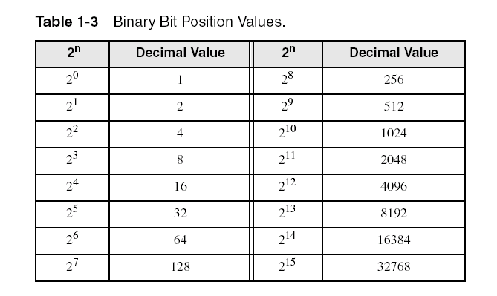
Data Representation: Binary Numbers (Integers)
Each digit (bit) is either 1 or 0
Each bit represents a power of 2:
Every binary number is a sum of powers of 2

Slide 22
Data Representation: Translating Binary to Decimal
Weighted positional notation shows how to calculate the decimal value of each binary bit:
dec = (D_{n-1} × 2^{n-1}) + (D_{n-2} × 2^{n-2}) + ... + (D₁ × 2¹) + (D₀ × 2⁰)
D = binary digit
binary 00001001 = decimal 9:
(1 × 2³) + (1 × 2⁰) = 9

Slide 23
Data Representation: Translating Binary to Decimal

Slide 24
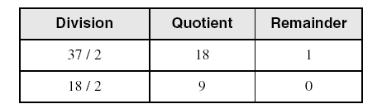
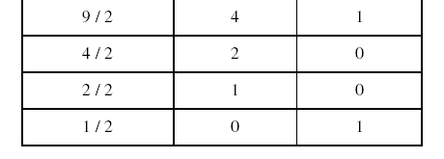
Data Representation: Translating Unsigned Decimal to Binary
Repeatedly divide the decimal integer by 2.
Each remainder is a binary digit in the translated value:
37 = 100101

Slide 26
Data Representation: Binary Addition
Starting with the LSB, add each pair of digits, include the carry if present.

Slide 27
Data Representation: Integer Storage Sizes
Standard sizes (x86):
What is the largest unsigned integer that may be stored in 20 bits?

Slide 30
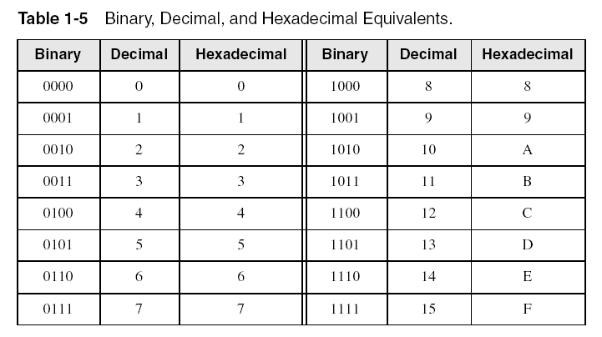
Data Representation: Hexadecimal Integers
Binary values are represented in hexadecimal (Why).
Large binary numbers are hard to read

Slide 31

Data Representation: Translating Binary to Hexadecimal
Each hexadecimal digit corresponds to 4 binary bits (Why?).
Example: Translate the binary integer
000101101010011110010100
to hexadecimal:

Slide 32
Data Representation: Converting Hexadecimal to Decimal
Multiply each digit by its corresponding power of 16:
dec = (D₃ × 16³) + (D₂ × 16²) + (D₁ × 16¹) + (D₀ × 16⁰)
Hex 1234 equals (1 × 16³) + (2 × 16²) + (3 × 16¹) + (4 × 16⁰), or decimal 4,660.
Hex 3BA4 equals (3 × 16³) + (11 * 16²) + (10 × 16¹) + (4 × 16⁰), or decimal 15,268.

Slide 33
Data Representation: Converting Hexadecimal to Decimal

Slide 34
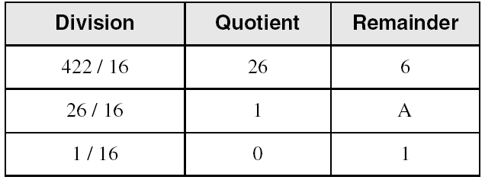
Data Representation: Converting Decimal to Hexadecimal
decimal 422 = 1A6 hexadecimal

Slide 35
Data Representation: Hexadecimal Addition
Divide the sum of two digits by the number base (16). The quotient becomes the carry value, and the remainder is the sum digit.
1
1
36 28 28 6A
42 45 58 4B
78 6D 80 B5
21 / 16 = 1, rem 5
Important skill: Programmers frequently add and subtract the addresses of variables and instructions.

Slide 37
Data Representation: Hexadecimal Subtraction
When a borrow is required from the digit to the left, add 16 (decimal) to the current digit's value:
16 + 5 = 21
−1
C6 75
A2 47
24 2E
Notes:
0000004A → 74 bytes or 1 byte?

Slide 38
Data Representation: Signed Integers
Challenges -
Dealing with both positive and negative numbers
Simplify the Circuit design

